Slide 1
Clustering
Continued

Slide 2
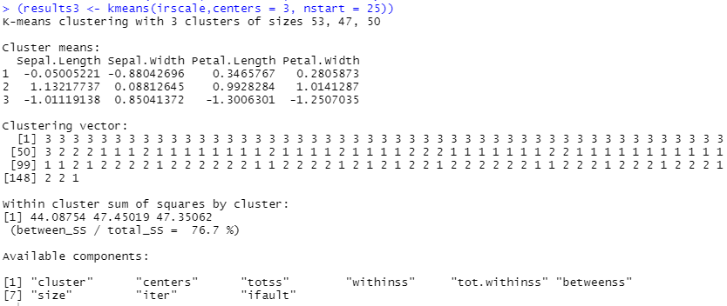
Return to iris data and k-means clustering, k = 3

Slide 3



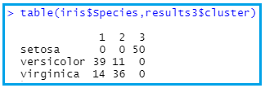
New flower to classify
New flower:
Sepal Length 5.1, Sepal Width 3.7, Petal Length 1.5, Petal Width 2.0
First, need to scale these data, using same transformation used initially.
SL = -0.8976739, SW = 1.474458, PL = -1.279104, PW = 1.050416

Slide 4
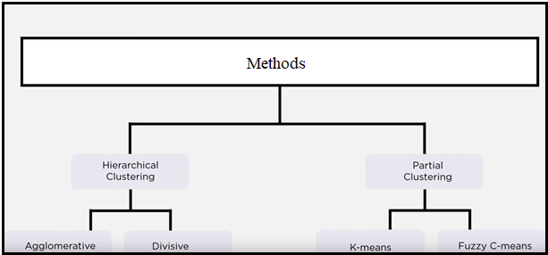
More Clustering
Bottom-up approach

Slide 5
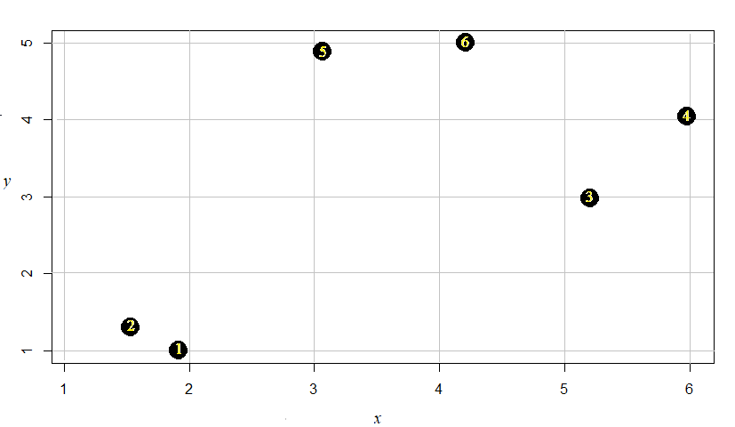
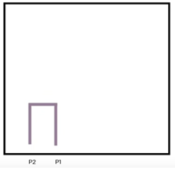
Bottom-up approach

Slide 6
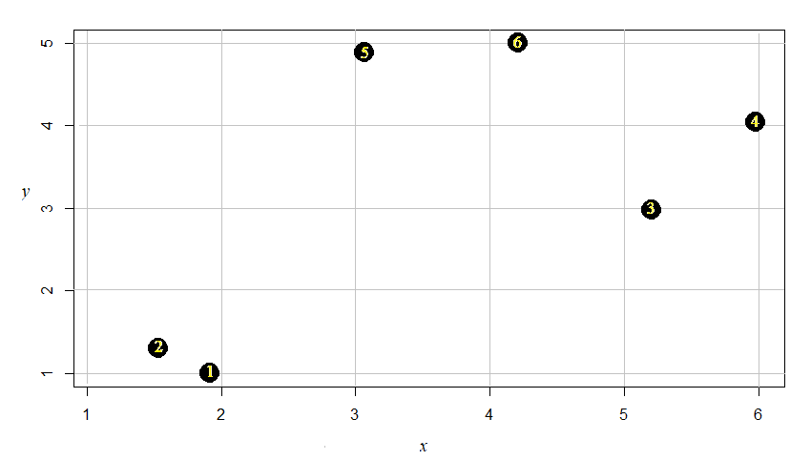
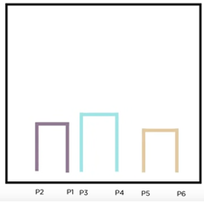
The next two clusters/datapoints are merged. Tree like structure called Denogram.

Slide 7
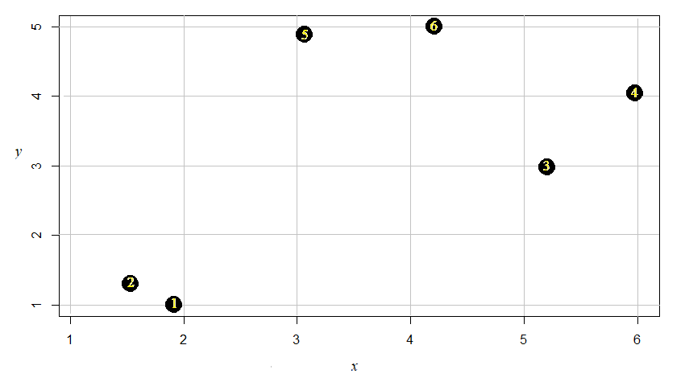
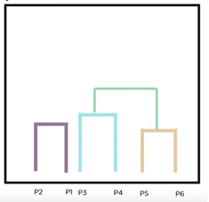
The nearest clusters are merged.

Slide 8
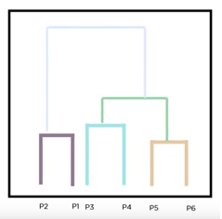
Final Step: Merging last two clusters

Slide 9
Hierarchical Clustering
Alternative to k-means clustering algorithm
Does not require pre-specified number of clusters (but can choose a limit)
Can specify what distance metric to use
Can specify “linking”
Centroid Linkage Clustering: Calculate the centroid within each cluster and use the distance between each centroid to determine whether to merge two clusters.
To interpret, helpful to have domain knowledge

Slide 10
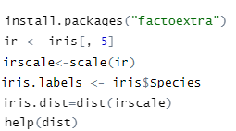
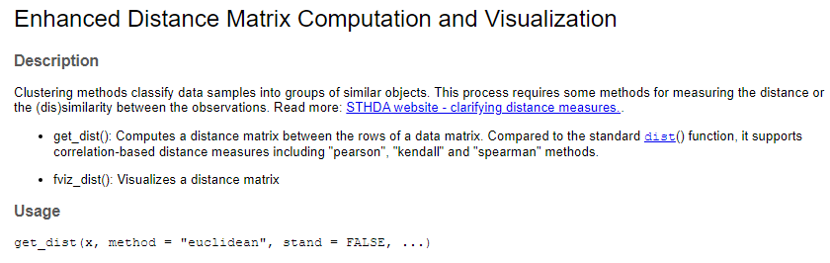
Return to iris data

Slide 11
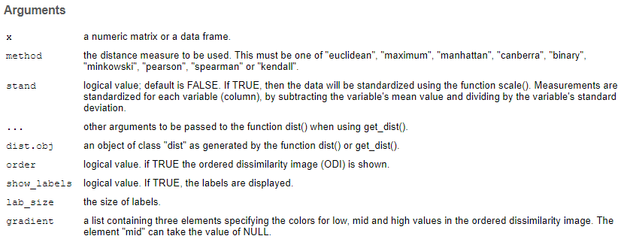

Slide 12
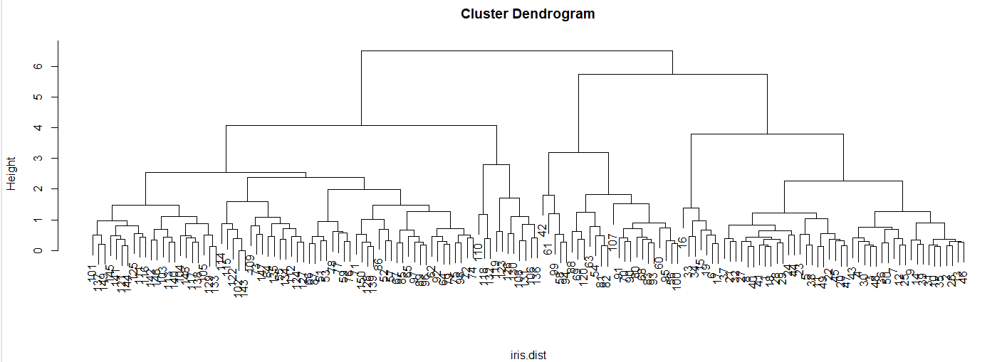

Slide 13

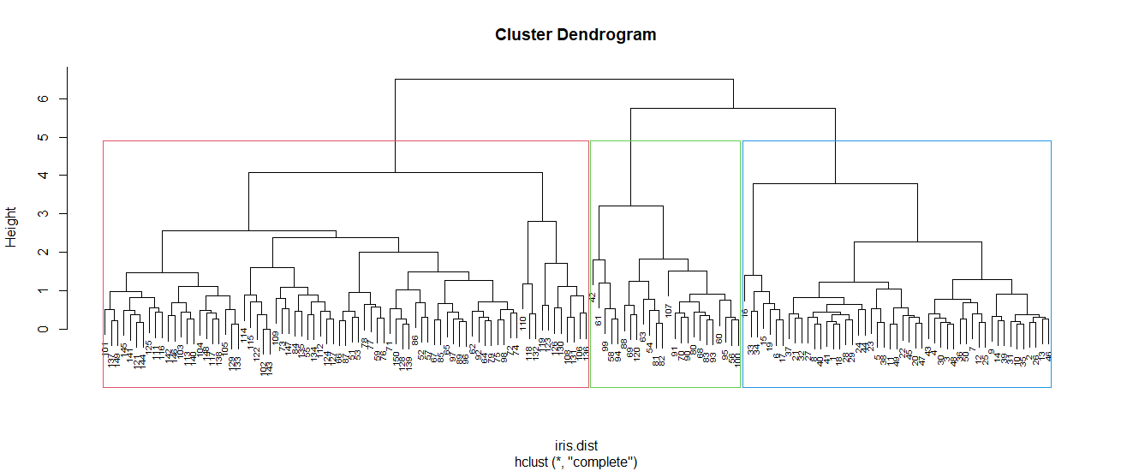

Slide 14

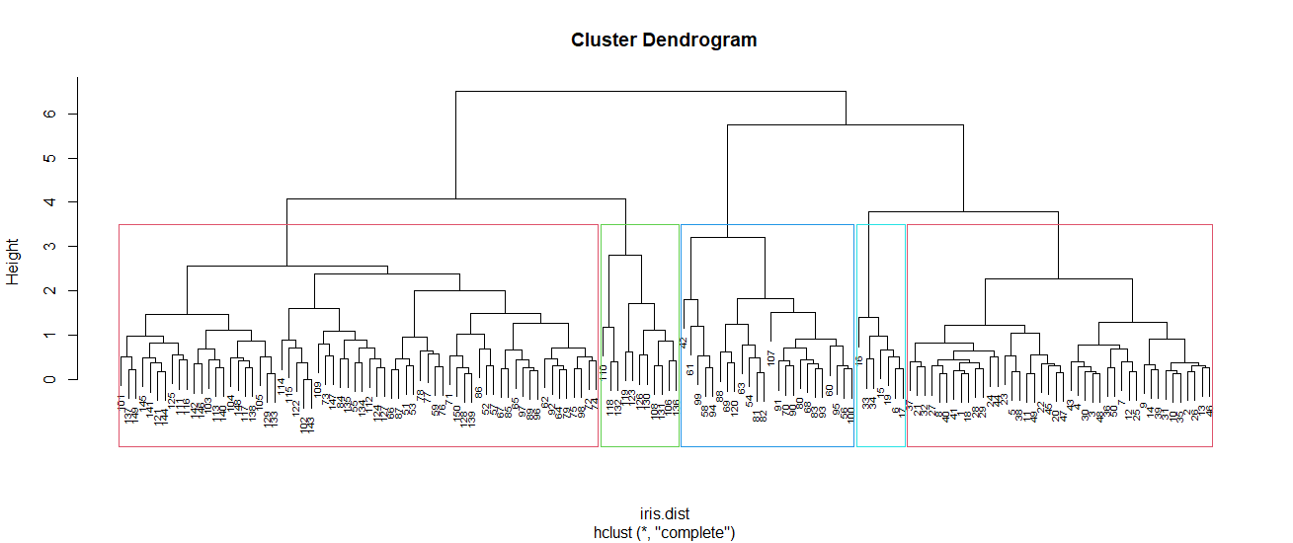

Slide 15
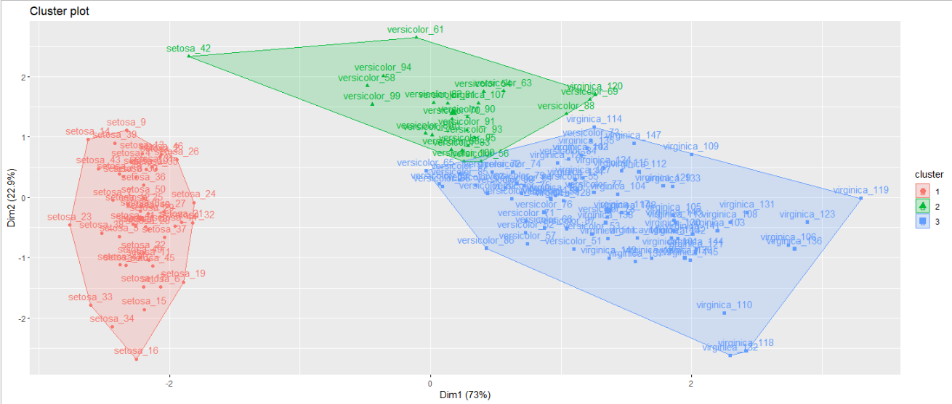

Slide 16

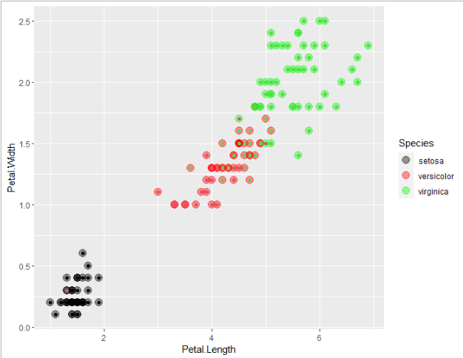

Slide 17


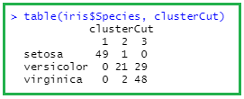
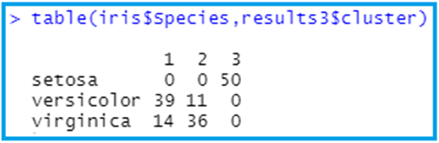
Comparing to k-means clustering
Cluster numbers in
reverse order
1 -> 3, 2 -> 2, 3 -> 1

Slide 18
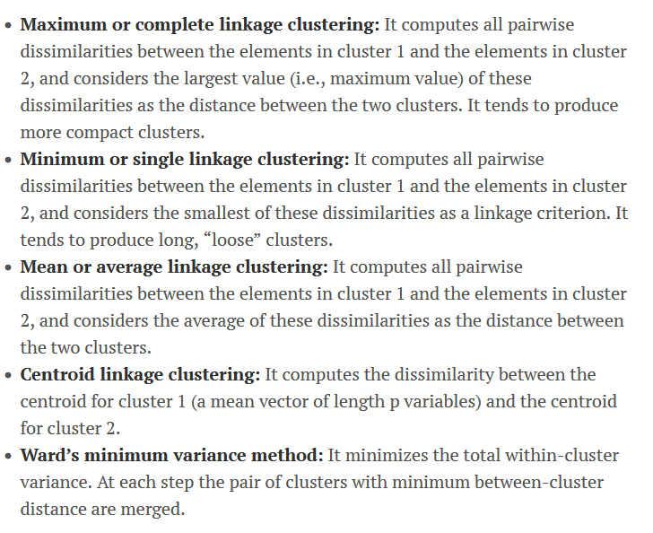
Different linkage options

Slide 19

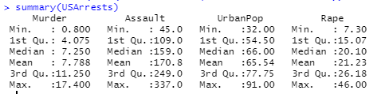
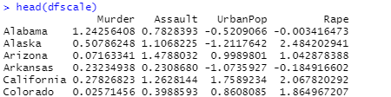

https://uc-r.github.io/hc_clustering (USArrests, statistics in arrests per 100,000 residents in each of 50 US states)

Slide 20
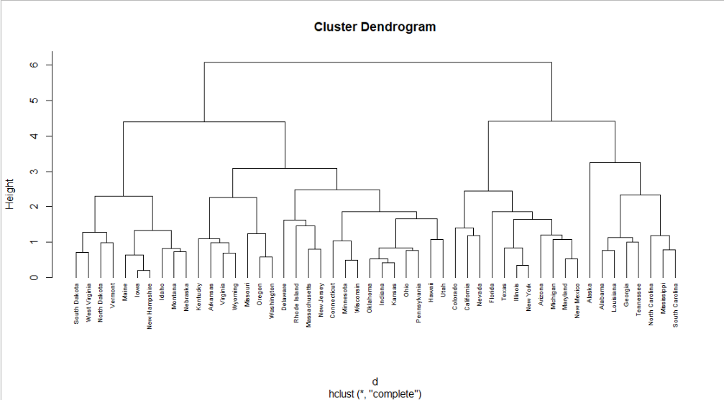

Slide 21

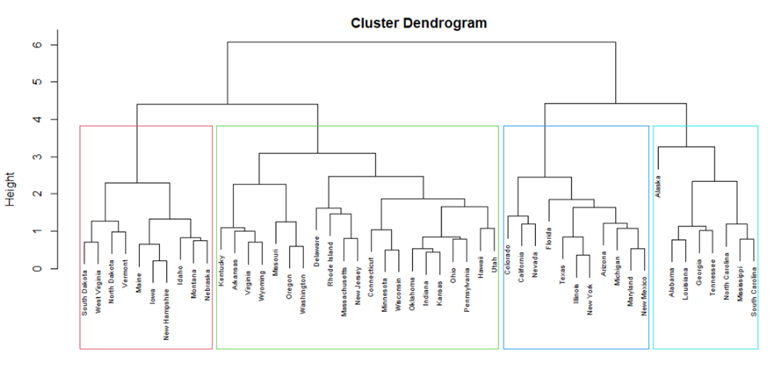

Slide 22
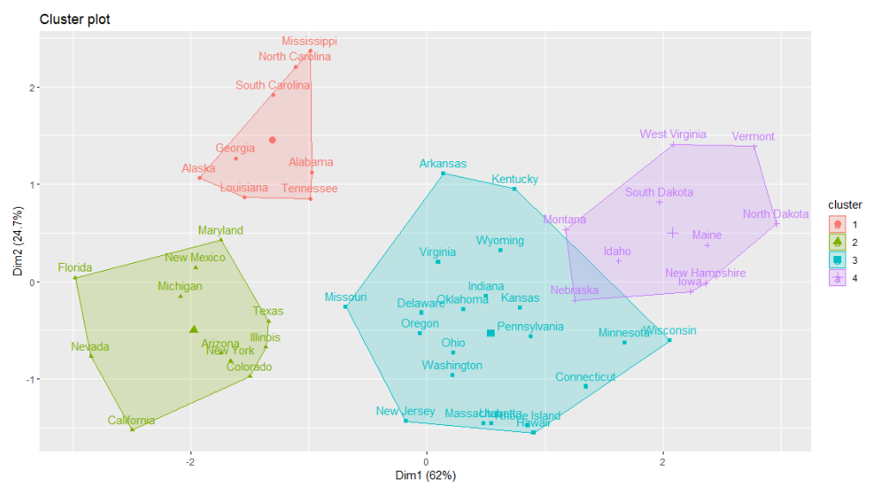

Slide 23
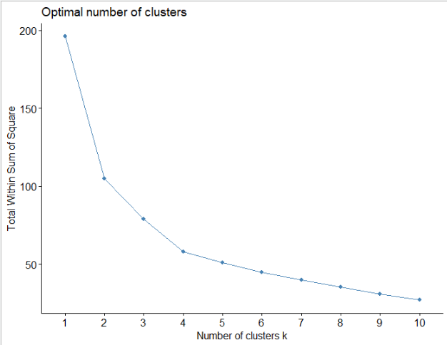
Elbow Method: determining number clusters
Elbow

